Slide 1


Programming Microcontrollers
A Computer Scientist’s perspective
March 2022
André Pereira

Slide 2
Agenda
Goals & Pre-requisites
Programming abstraction levels
What’s an Instruction Set Architecture?
CISC vs RISC
Microprocessors and microcontrollers
Practical exercises

Slide 3
Goals
Understand the architectural differences between microprocessors and microcontrollers
Learn how to code and interact with a microcontroller
Apply the fundamentals of microprocessor programming in assembly to microcontrollers

Slide 4
Pre-requisites
Previous enrollment in the Sistemas de Computação Curricular Unit
A laptop with the AVR_SIM v2.5 tool installed
Available for Linux and Windows
Download: http://www.avr-asm-tutorial.net/avr_sim/index_en.html#download
Work with a colleague!
Patience for my lack of knowledge in electronic engineering

Slide 5
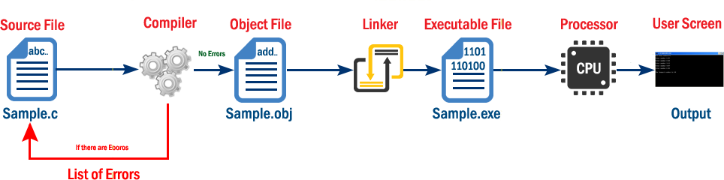
Abstraction Levels
High Level Languages (HLL)
Independent of the hardware
Various programming paradigms (functional, imperative, object-oriented, …)
User usually codes at this abstraction level
Python, C/C++, Java, …
Assembly Languages
Machine Languages

Slide 6
Abstraction Levels
High Level Languages (HLL)
Assembly Languages
Hardware supports a given Instruction Set Architecture (ISA)
Availability of instructions is dependent on the hardware
Several ISAs available
IA-16/32, x86/x64, MIPS, …
Machine Languages

Slide 7
Abstraction Levels
High Level Languages (HLL)
Assembly Languages
Machine Languages
A list of commands supported by the hardware
Dependent on the specific chip
Chips from the same architecture may have different commands
Represented as pure binary
Two design philosophies, which impact the supported ISA
Complex Instruction Set Computers (CISC)
Reduced Instruction Set Computers (RISC)

Slide 8
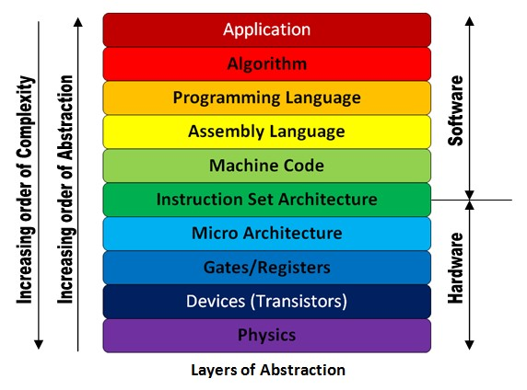
Instruction Set Architecture (ISA)
Defines a set of instructions to control the behavior of a chip
Logic and arithmetic operations
Operand data access
Control of the execution flow
Input/output and others
Imposes restrictions to the instruction representation in memory

Slide 9
Instruction Set Architecture (ISA)
Defines a set of instructions to control the behavior of a chip
Imposes restrictions to the instruction representation in memory
Assembly reflects the instructions at HW level
Variable vs fixed instruction length

Slide 10
ISA – Supported Operations
Logic and arithmetic operations
And, or, xor, not, cmp, …
Add, sub, mul, div, inc, dec, …
ISA defines the number of operands for each instruction
3 operands – RISC for microprocessors (ex., ARM)
2 operands – RISC/CISC for microprocessors (ex., IA-16)
1 operand – RISC for microcontrollers
0 operands – RISC/CISC

Slide 11
ISA – Access and Types of Operands
Operand types
Immediates
Scalars in registers
Complex data structures in memory (ex., C structs, arrays)
Operand data access
RISC
L&A ops – all operands in registers
Few address specification modes
32 general purpose registers
CISC
L&A ops – operands in registers or register/memory
Several address specification modes
8 general purpose registers (IA-16)

Slide 12
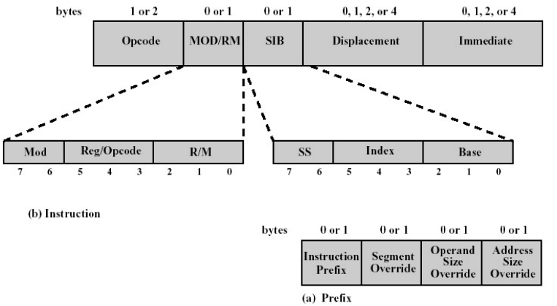
ISA – Instruction Length in Memory
Variable instruction length
Instructions can range from 1 to several bytes
Representation organized in sections
The sections used may vary between instructions
Code requires less memory space (a big limitation in the past)
More complex Control Units and Decoder are required
Slow(er) fetch and decoding of a complex instruction
IA-32

Slide 13
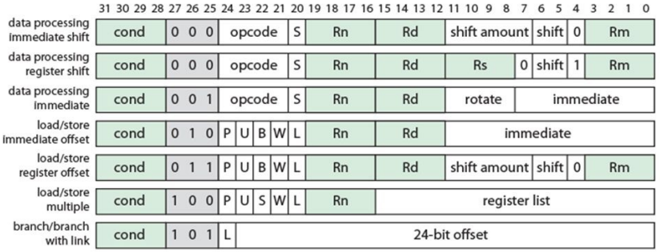
ISA – Instruction Length in Memory
Fixed instruction length
Instructions often coded using 32 bits
Representation organized in sections
Unused sections are offset to add up to 32 bits
Larger in-memory code bases (still a few KiBs to MeBs)
Simpler and faster decoding
ARM

Slide 14
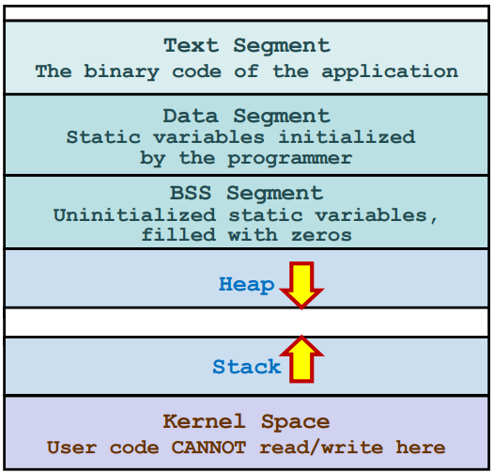
Program Organization in Memory

Slide 15
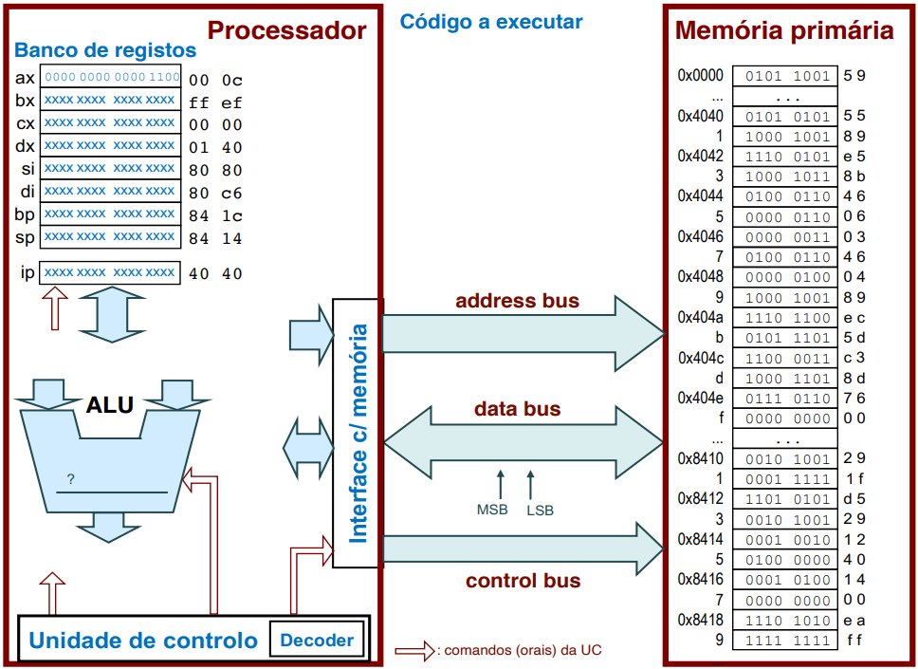




Instruction Execution on IA-16 (CISC)

Slide 16
A CISC vs RISC Summary
CISC (IA-16)
RISC
6+2 generic registers
Intensive use of the stack
Local variables
Function argument passing
Memory accesses are not efficient!
Smaller codebases in memory
Variable length instructions
Complex operations
Ex. push
16 to 32 generic registers
Stack used much less
Fewer variables in memory
Registers used to pass arguments to functions
Function return address in register
Larger codebases in memory
Fixed length instructions
Simpler operations
Ex. push -> sub + store

Slide 17
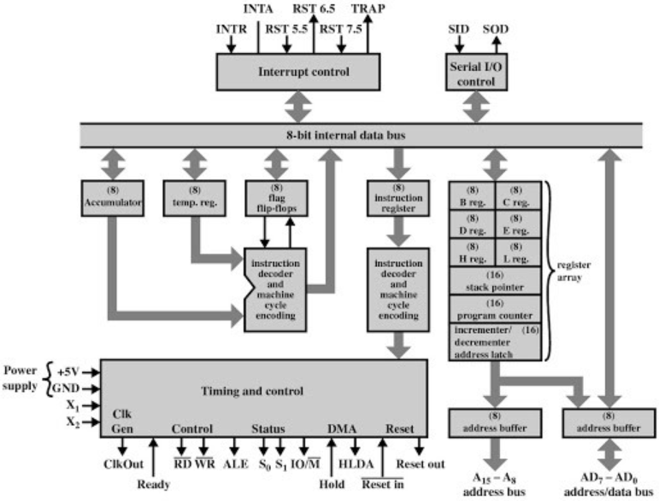
Microprocessor Architecture
Intel 8085 (1976)

Slide 18
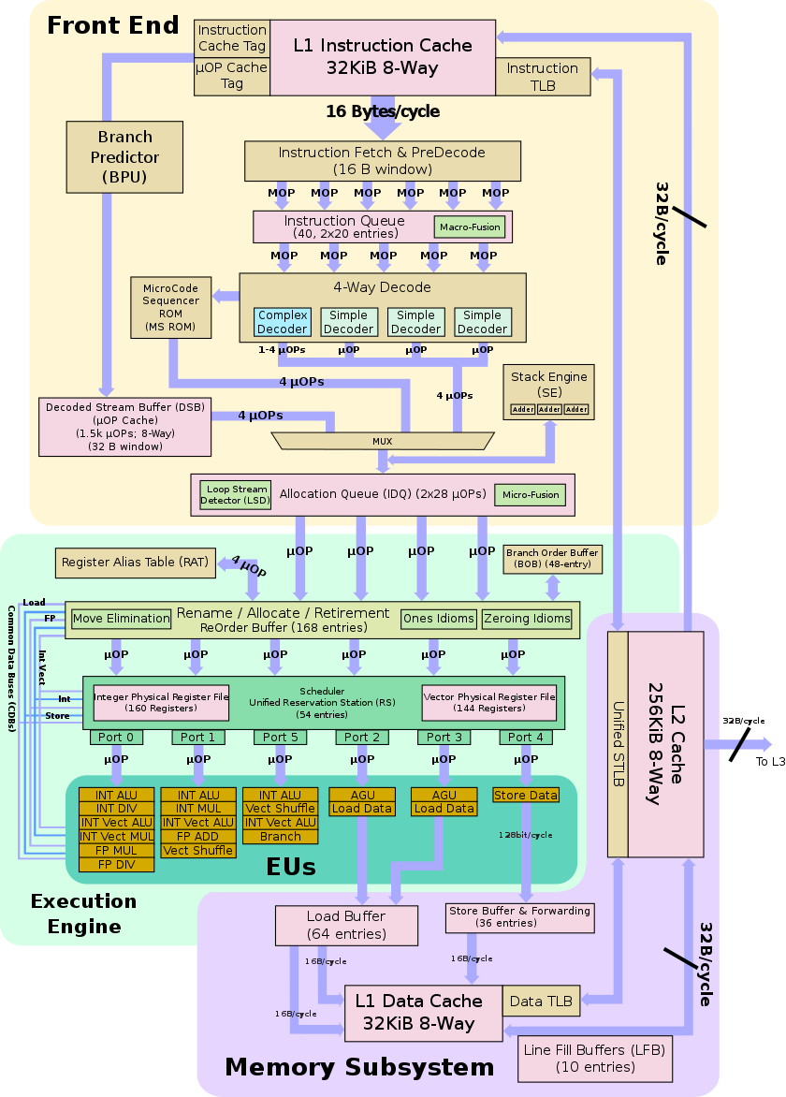
Microprocessor Architecture
Intel Ivy Bridge (2012)

Slide 19
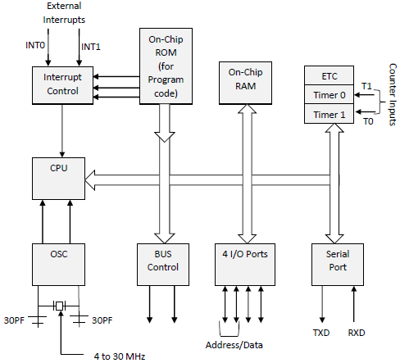
Microcontroller Architecture
Intel 8051 (1980)

Slide 20
Microcontroller Architecture
Intel 8051 (1980)

Slide 21
The Differences
Microprocessor
Microcontroller
Chips designed for computation
Generic operations (add, sub, …)
Complex operations (sin, cos, …)
Different designs for different computations
Usually computational efficiency is key
Fast clock speeds (up to 5.4 GHz)
Expensive and complicated
Must be integrated into a system
Generic use
Chips designed for electronic device control
Integrates a simple microprocessor
Embeds memory (volatile and non-volatile) and I/O
Energy efficiency and thermal dissipation are key
Slow clock speeds (< 200 MHz)
Cheap and simple
SoC-like
Application specific

Slide 22
Microcontroller Programming Models
Linear/Imperative
Interrupt based
Program based on statements
Change the program state
Statements define commands for the system to execute
Implements how a program performs an algorithm
Statements executed in sequence by default
C, Fortran, IA-32 ISA, …
Hardware interrupts trigger function calls
Software interrupts not usually supported
Can happen in the middle of a multi-cycle instruction execution
Interrupts must be dealt with immediately
Functions often programmed linearly
ATMEL ISA, …

Slide 23
Microcontroller Programming Models
Interrupt based
Hardware interrupts trigger function calls
Software interrupts not usually supported
Can happen in the middle of a multi-cycle instruction execution
Interrupts must be dealt with immediately
Functions often programmed linearly
ATMEL ISA, …

Slide 24
ATMEL Microcontrollers
ATTiny13
RISC (120 ins)
8 bit
32 8bit general purpose registers
1 – 10 MHz
1 KiBytes flash storage
1x 8bit timer
6 I/O lines (ports)
…
ATMega32
Advanced RISC Arch (131 ins)
32 8bit general purpose registers
32 KiBytes flash storage
1 – 16 MHz clock
2x 8bit + 1x 16bit timers
32 I/O lines
Peak Instruction throughput: 1MIPS @ 1 MHz

Slide 25
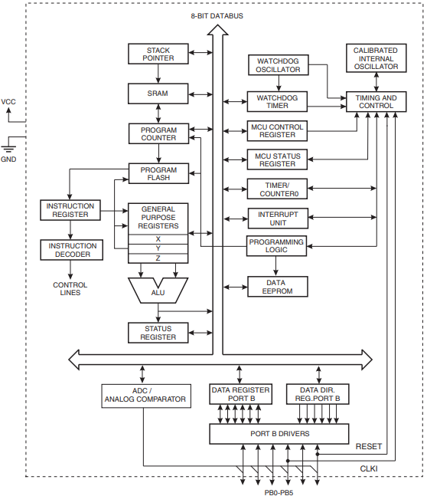
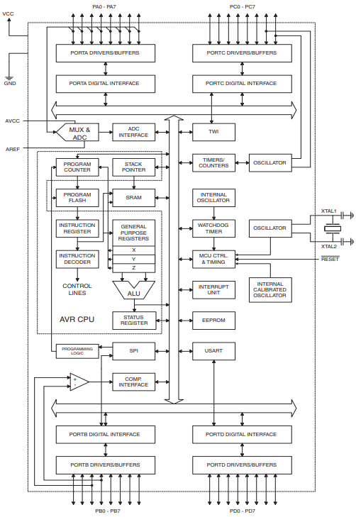
ATMEL Microcontrollers
ATTiny13
ATMega32

Slide 26
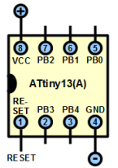
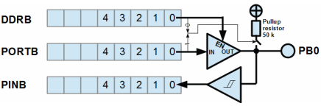
ATTiny13
5 I/O addressable port pins: PB0 to PB4
Each controlled by a bit in DDRB and PORTB “registers”
DDRB (Data Direction Register port B): 1/0 -> output/input (extremely simplified, depends on breadboard setup)
PORTB (data output register port B): 1/0 -> high/low voltage
PINB (input register B): stores the logical state of the port pin
Processing unit programmed similarly to RISC microprocessors

Slide 27
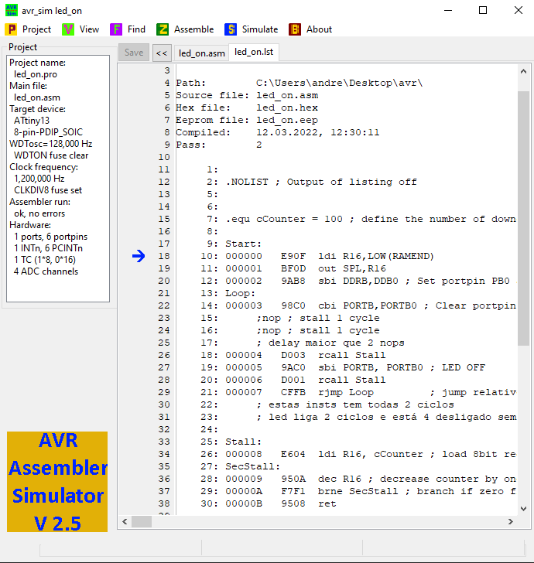
AVR Simulator
Tool for the simulation of code execution in microcontrollers
Assembles the ISA to produce machine code
Simulates ATMEL microcontrollers
Allows full control of
View and change bits in memory and registers
Timer and interrupt manipulation
Microcontroller clock frequency
Looks are inversely proportional to the tool potential/usefulness

Slide 28
Practical Session
https://github.com/ampereira90/microcontrollers

Slide 29
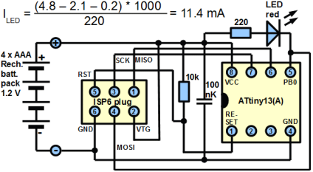
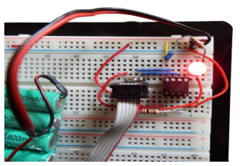
A Practical Example (1)
Switch a LED on/off each couple of cycles
In a “sink” configuration, output bit turns on the LED

Slide 30
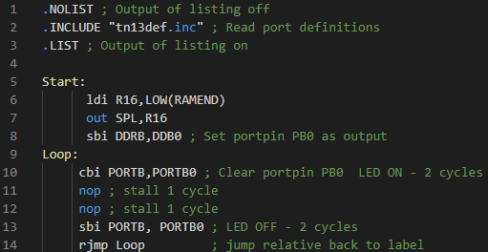
A Practical Example (1) > led_on_off.asm file
How long does the LED stays on and off?
Let’s simulate this!

Slide 31
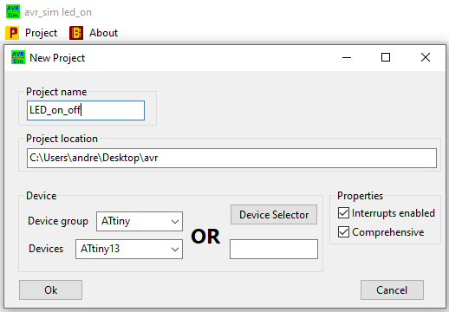
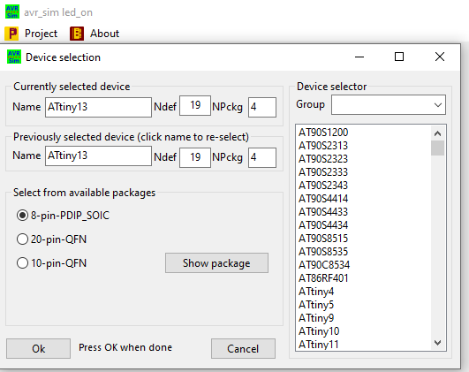
A Practical Example (1) > led_on_off.asm file
Create a “New Project” in AVR_SIM
Delete all default code and implement your own
“Assemble” and then “Simulate”

Slide 32
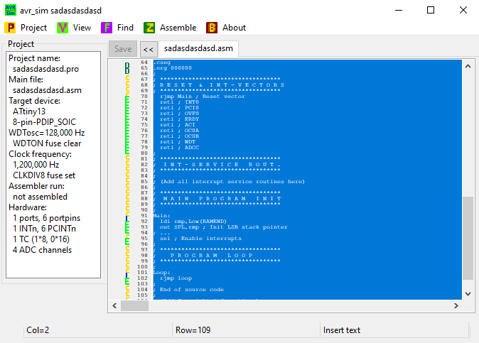
A Practical Example (1) > led_on_off.asm file
Create a “New Project” in AVR_SIM
Delete all default code and implement your own
“Assemble” and then “Simulate”

Slide 33
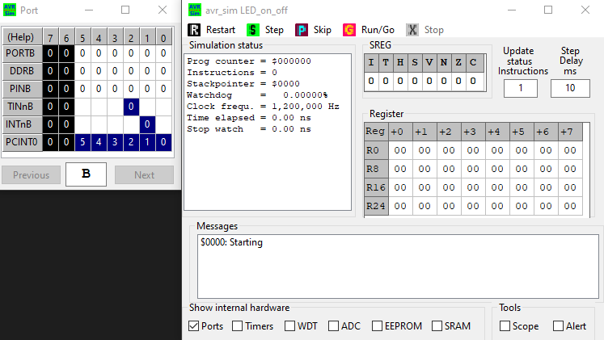
A Practical Example (1) > led_on_off.asm file
“Step” executes the next instruction
“Run” executes the whole program

Slide 34
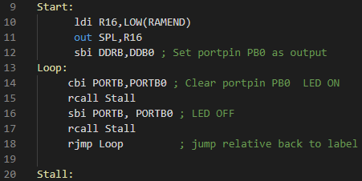
A Practical Example (2) > led_on_off_stall.asm file
Let’s complicate it
Replace the “nops” by a function call to “Stall”
“Stall” function should delay the execution by 100 cycles

Slide 35
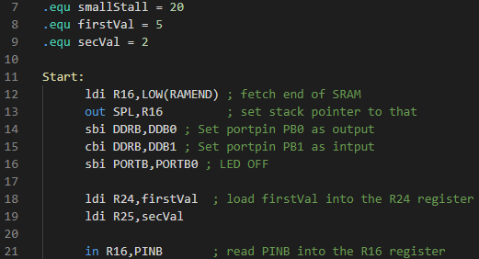
A Practical Example (3) > led_on_off_counter.asm file
Implement a program that
Reads the PINB1 bit
If the bit is 0 add R24 to R25
If the bit is 1 subtract R24 to R25
Flash the LED x times with an interval of 20 cycles
Where x is the result of the addition/subtraction
Draw a diagram of the execution flow and tasks before coding!

Slide 36
Relevant Instructions – ATMEL ISA
IA-16 ISA | ATMEL ISA | Description
add r1, r2 | add r2, r1 | r2 = r2 + r1
sub r1, r2 | sub r2, r1 | r2 = r2 – r1
inc r1 | inc r1 | r1 = r1 + 1
dec r1 | dec r1 | r1 = r1 – 1
mov v1, r1 | ldi r1, v1 | r1 = v1
jmp label | rjmp label | ProgramCounter = label
call func | rcall func | ProgramCounter = func
jne | brne | Jump if ZF not set
- | in r1, PINB | Loads from I/O space to r1
- | out PINB, r1 | Stores r1 on I/O space
- | sbi PORTB, PORTB0 | PORTB0 bit set to 1 in PORTB
- | cbi PORTB, PORTB0 | PORTB0 bit set to 0 in PORTB
and r1, r2 | and r2, r1 | r2 = r1 & r2
and $v, r1 | andi r1, 0x00 | r1 = r1 & immediate

Slide 37
References

Slide 38
Programming Microcontrollers
The end
March 2022
André Pereira

